Slide 1
Mentor Mentee Management System
USING JAVA
URK22CO2021
URK22CS1164
URK22CS3022

Slide 2
INTRODUCTION
Mentorship is a journey of growth, knowledge sharing, and support. It's a relationship that has the power to shape careers, open doors, and inspire dreams. Today, we invite you to explore a cutting-edge Mentor-Mentee Management System built on the strong foundation of Java.
Our Mentor-Mentee Management System is the bridge that connects eager learners (mentees) with experienced guides (mentors), fostering a supportive ecosystem for personal and professional development.

Slide 3





OBJECTIVES
Data Collection and Storage
User-Friendly Interface
Error Handling
Data Validation
User Notification

Slide 4
Methodology and Approach
The code uses Java Swing for creating a GUI application.
It organizes the UI components and functionality into different methods.
File I/O is used to store and retrieve mentee details and meeting information.
The code structure follows a modular approach, with separate methods for different functionalities.
It provides a basic but functional interaction flow for mentors and mentees.

Slide 5
System Architecture
Mentor-Mentee System has a basic two-tier system architecture,
Presentation Layer: This is where the user interface resides. The code uses Java Swing for creating the graphical interface, including buttons and text fields. Users interact with the system by entering data and clicking buttons. Event listeners are used to respond to user actions.
Data Storage Layer: Data is managed through file input/output operations. Mentee details are stored in a text file named "mentee_details.txt," and meeting details are saved in "meetings.txt." The code reads and writes data directly from and to these files.
This architecture is simple and suitable for personal desktop usage but may need improvements for scalability and robust data management.

Slide 6
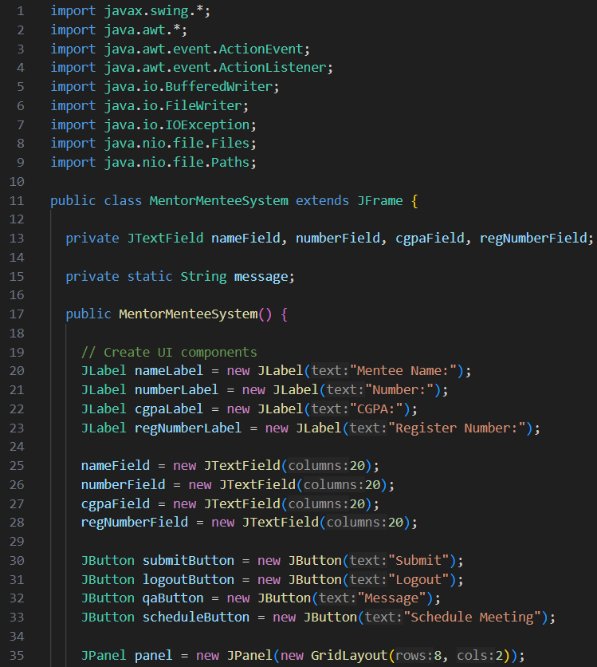
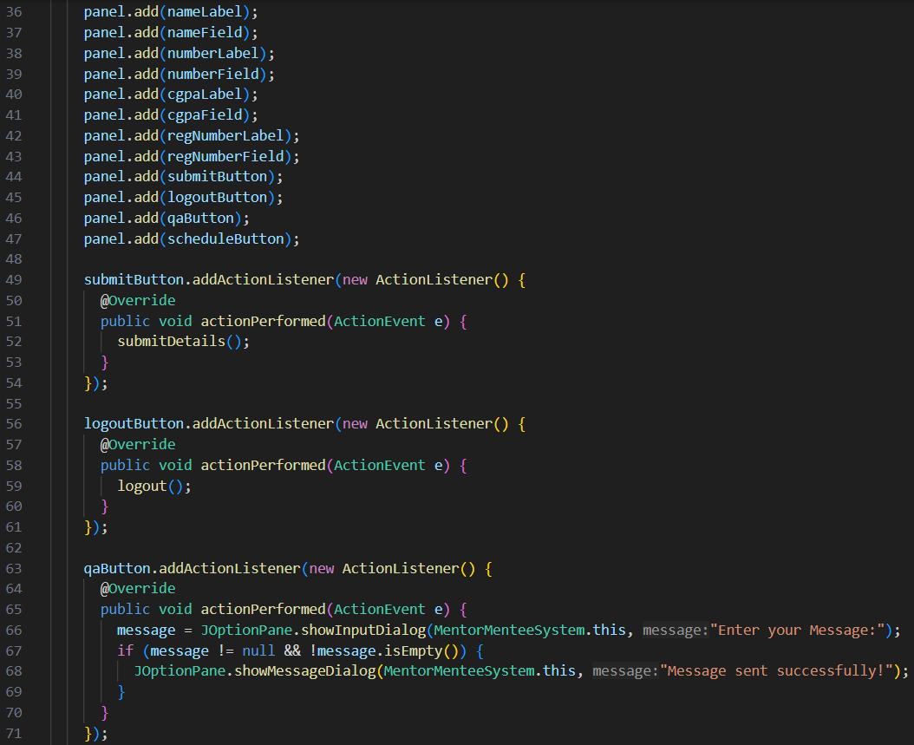
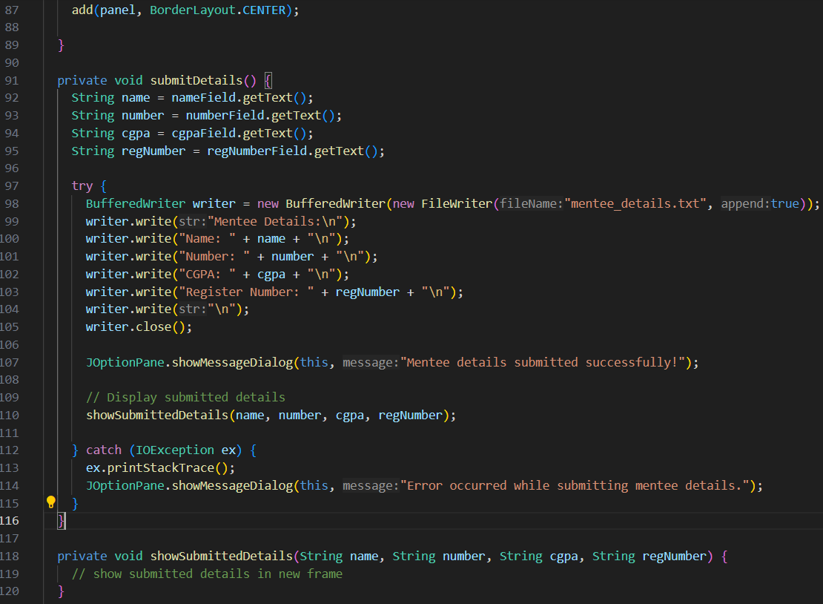
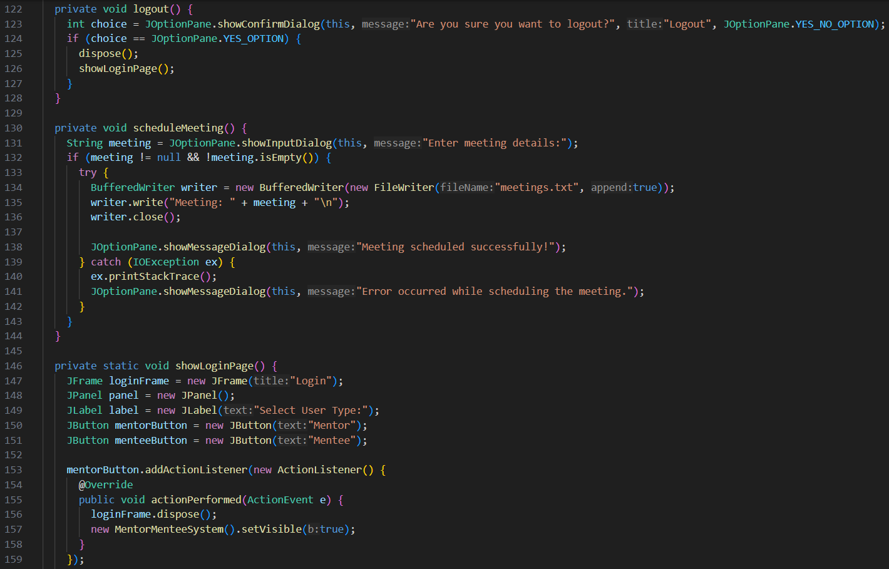

Implementation

Slide 7
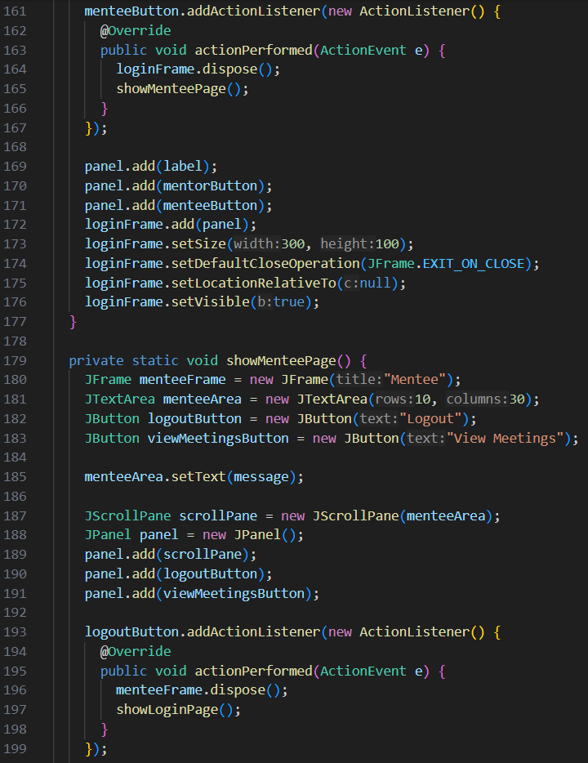
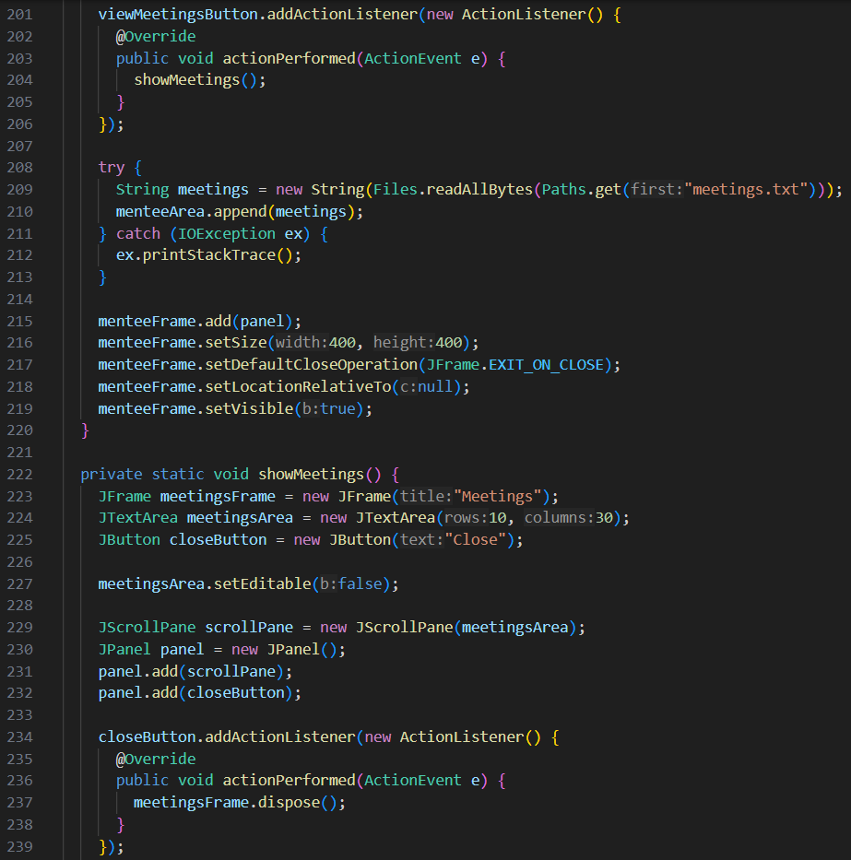
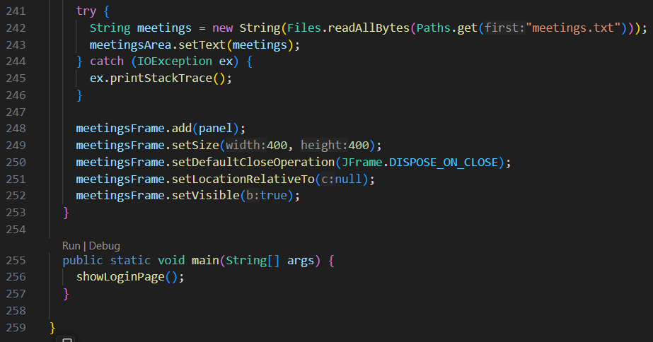
Implementation

Slide 8
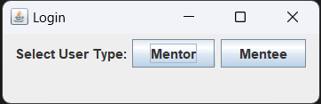
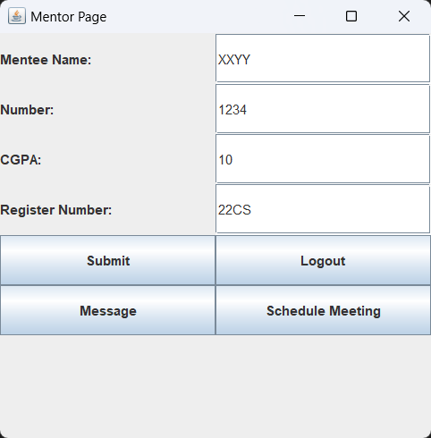
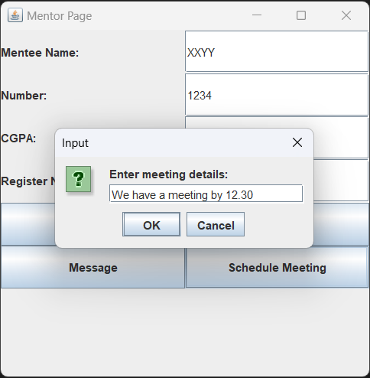
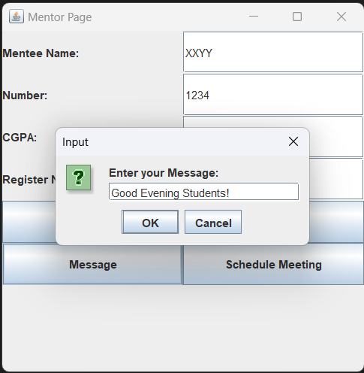
User Interface

Slide 9
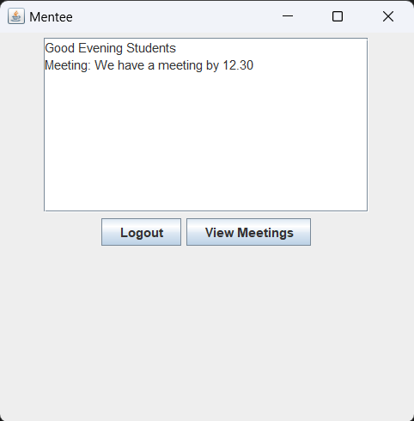
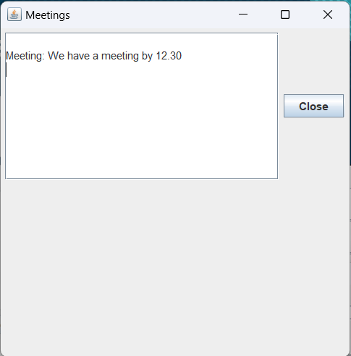
User Interface

Slide 10
Project Impact
Improved Mentor-Mentee Relationships: The system fosters stronger, more efficient communication between mentors and mentees, leading to deeper and more effective mentoring relationships.
Enhanced Learning and Skill Development: Mentees can receive timely guidance and support, resulting in improved learning outcomes and skill development. Mentors can provide targeted resources and feedback.
Convenient Scheduling: The scheduling feature streamlines the process of setting up mentor-mentee meetings, making it more convenient for both parties and improving the mentorship experience.
Efficient Record Keeping: The system maintains a comprehensive record of mentorship interactions, which helps track progress, identify areas of improvement, and ensure accountability.

Slide 11
Future Developments
AI-Powered Matchmaking: Implement an AI-based matchmaking system to intelligently pair mentors and mentees based on their goals, interests, and strengths. This can improve the quality of mentor-mentee relationships.
Feedback and Evaluation: Enhance the feedback and evaluation process by integrating tools that allow mentors and mentees to provide structured feedback and self-assessments. Use this data to improve the quality of mentorship.
Progress Tracking Dashboard: Create a dashboard for both mentors and mentees to track progress, goals achieved, and areas that need attention. Visualization tools can make this data more meaningful.
Database: Integrating a database into the Mentor-Mentee System is a valuable and feasible future development
Data Analytics for Decision-Making: Leverage advanced data analytics to identify patterns and trends in mentorship relationships. Use this data to make informed decisions about program improvements.
Mobile App : Develop a mobile application with offline capabilities to enable users to access resources and engage in mentorship even without an internet connection.

Slide 12
Conclusion
The Mentor-Mentee System strengthens mentor-mentee relationships.
It enhances learning outcomes and skill development.
The system streamlines scheduling and communication, making mentorship more efficient.
Integrating a database into the Mentor-Mentee System is a valuable and feasible future development

Slide 13
Thank You :)

